Slide 1
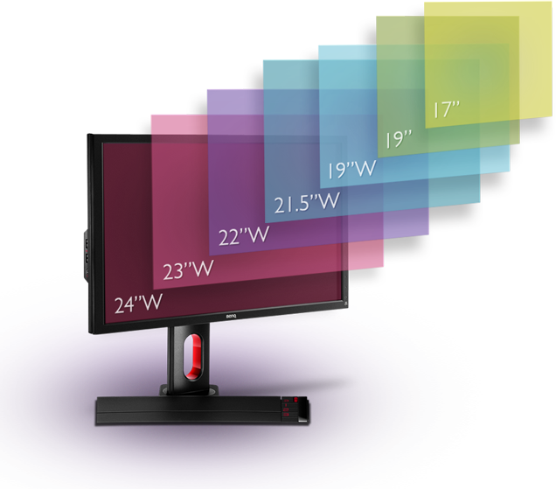
Effect of Display Size on a Player’s Situational Awareness in Real-Time Strategy Games
Peter Miralles
Chris Fernandes
CSC 499
Notes:
From the diaphram

Slide 2
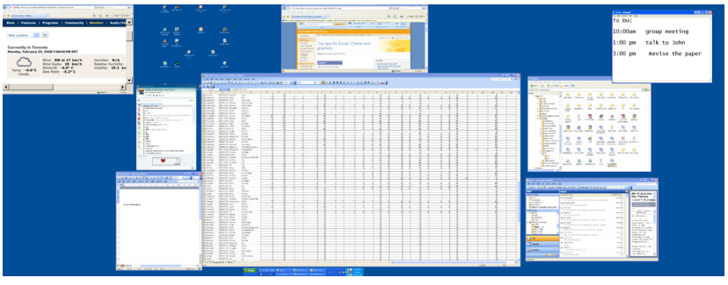
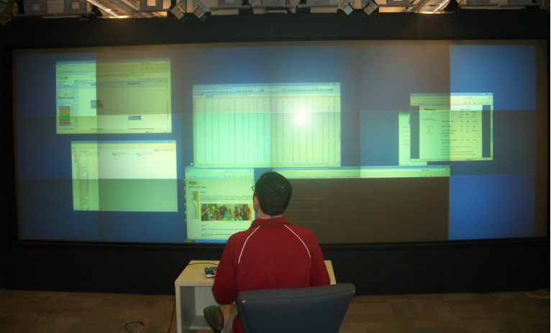
For everyday use Larger displays are helpful
Few consequences to slow retrieval of data.
Possible to have multiple windows opened at once.
Users focus on the center of the screen
Notes:
If you ask anyone bigger is better
Time critical sentence
Talk about lit
Center of screen is where you focus 3 “what happens if you cant move the information to the center of the screen but you still need all of it”

Slide 3
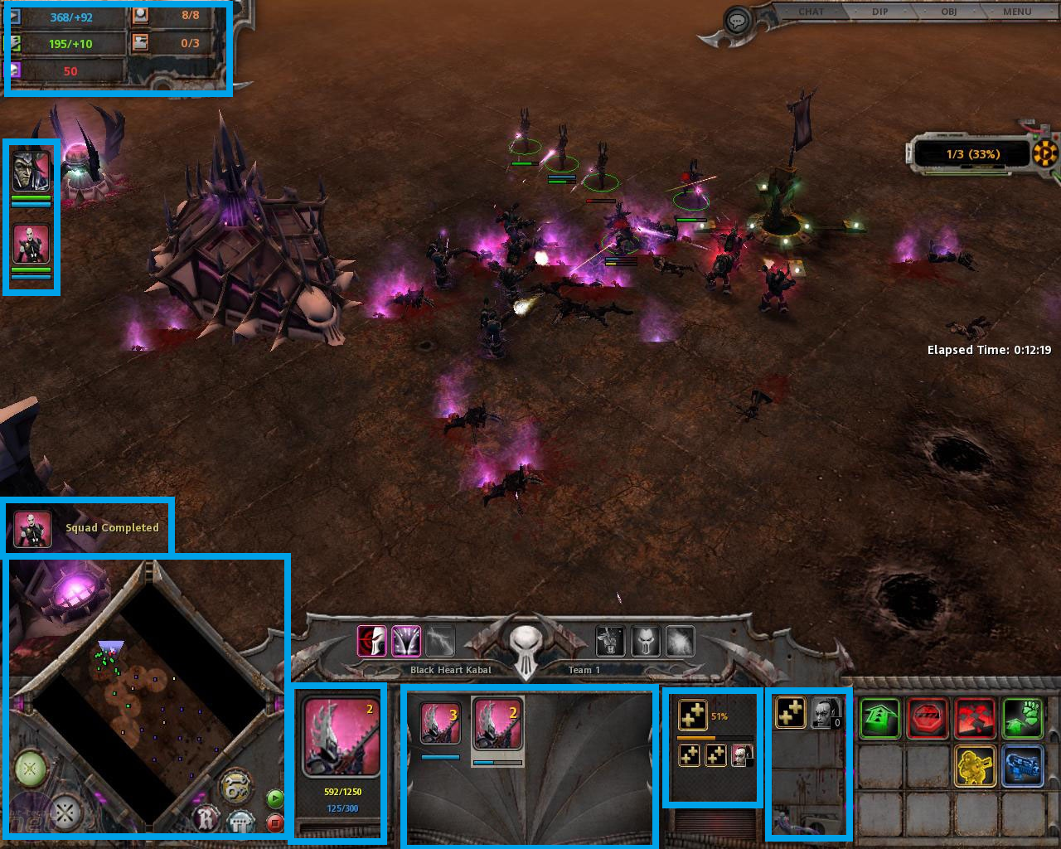
These traits do not apply when it comes to playing Videogames
Specifically Real-Time Strategy (RTS) games
RTS games critical information is locked in place
Happens in real-time
Moving large armies to destroy opponent’s army
Armies made of smaller characters called units
The map is made of terrain that has varying affects
Control strategic points
Notes:
Shorten bullets
“Bigger is better” does not apply to….
Bring five here

Slide 4
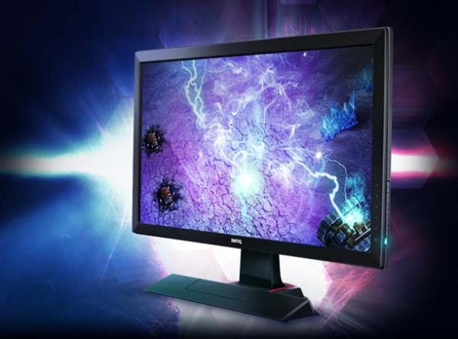
Does gaming with a large display improve the players situational awareness when playing RTS games?
Notes:
My hypopotomus is no
“What is situational awareness?”

Slide 5
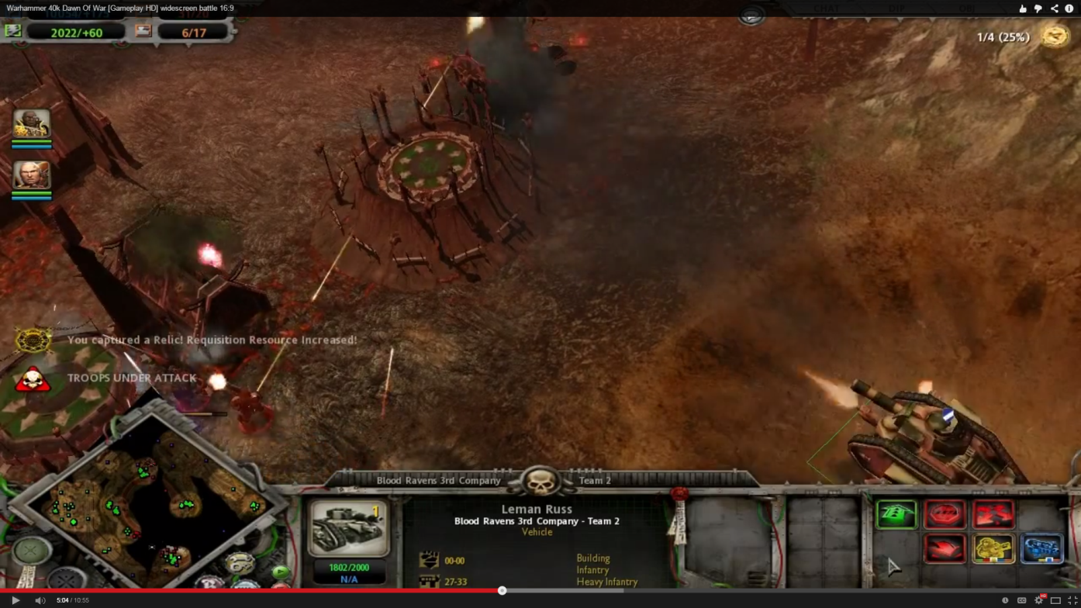
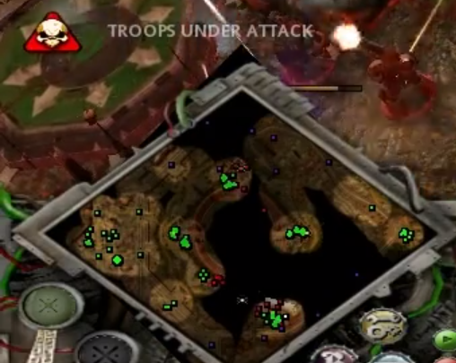
Situational Awareness
Ability to retrieve information quickly and being able to act on that information
Knowing what the most important thing to do at the time is
Notes:
Come up with an example

Slide 6
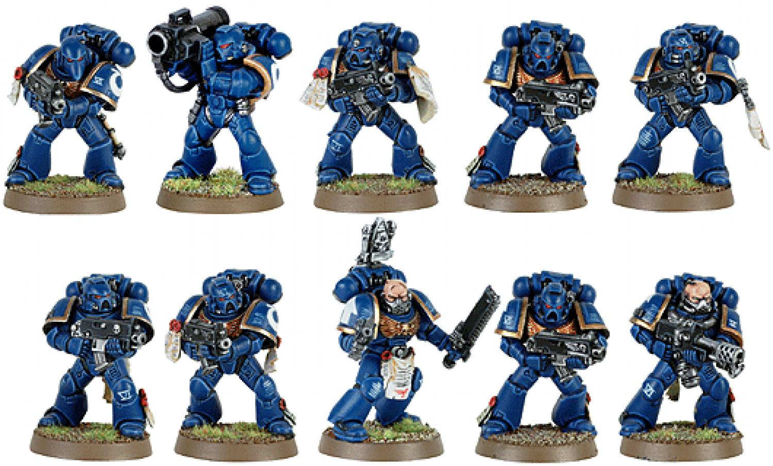
Recruitment and Basic expectations of subjects
Recruited through posters and acquaintances
Subjects should have some experience with video games
Notes:
Between subjects
Basic expectations of subject
What doing with subject
Individual slide for each wave
Picture or clip for each wave

Slide 7
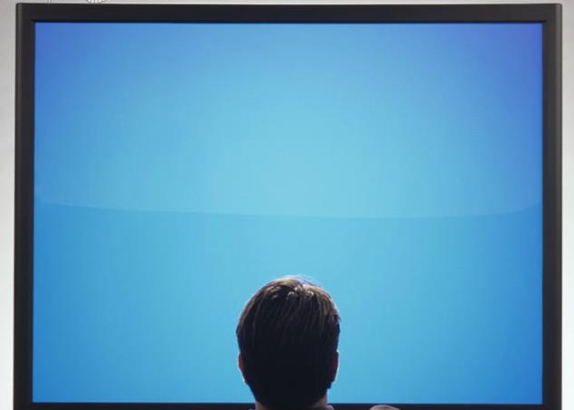
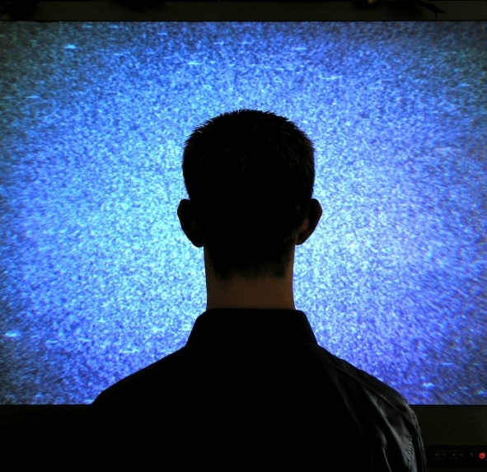
Experiment between subjects
Group 1
Wave 1 normal
Wave 2 normal
Wave 3 normal
Wave 4 normal
Group 2
Wave 1 Big
Wave 2 Big
Wave 3 Big
Wave 4 Big
Notes:
1 (teach participant that in one-on-one they will lose)
2 (how participant reacts to rocket launchers attacking their tank unit)
3 (see how participant reacts to second point being attacked while a first point is being attacked)
4 (similar to wave 3 though this time there are far fewer units for the participant to notice.)

Slide 8
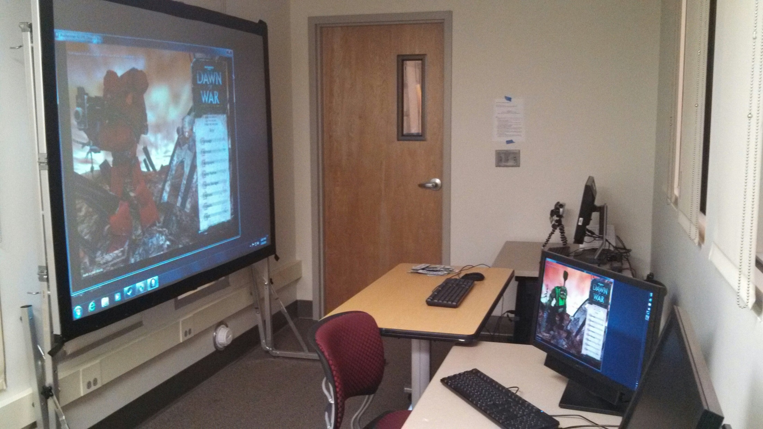
Experiment Setup

Slide 9
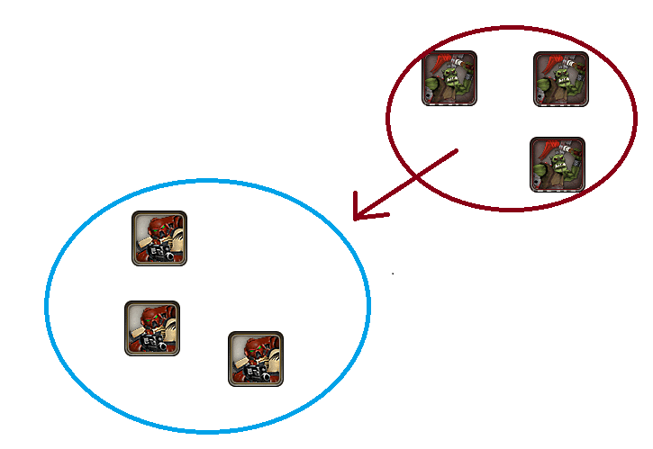
Wave 1
Three Space Marine squads
Three Ork Melee squads
Notes:
Here the Subjects were asked to hold a point against a wave of enemies with the three Space Marine squads they are given.
In this scenario there is no possible way for the subject to win.
This is used to teach the subject that if they just stand their ground against an enemy force they will lose the battle.

Slide 11
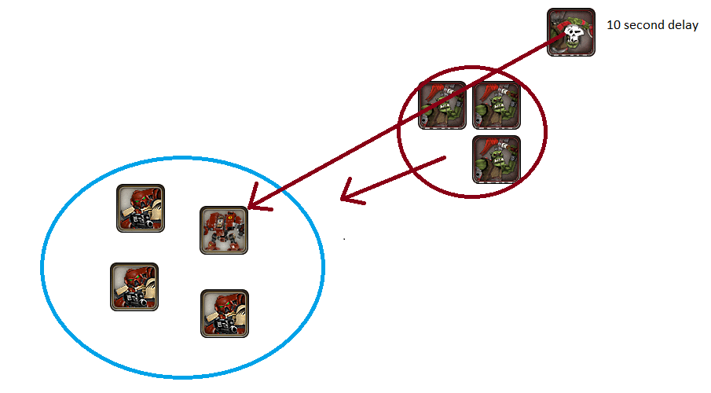
Wave 2
Three Space Marine squads, 1 Dreadnought
Three Ork melee unit attacking, 1 Ork rocket unit
Notes:
Here the subject is asked to defend the point with another three Space Marine squads along with a dreadnought which is their heavily armored unit.
This wave starts similarly to the first one with three Ork melee unit attacking, here the dreadnought shows how powerful it is by pushing back the Orks.
After this the another Ork unit attacks and this one has rocket launchers which can destroy the dreadnought.
Here the subject needs to notice this and react to it.

Slide 13
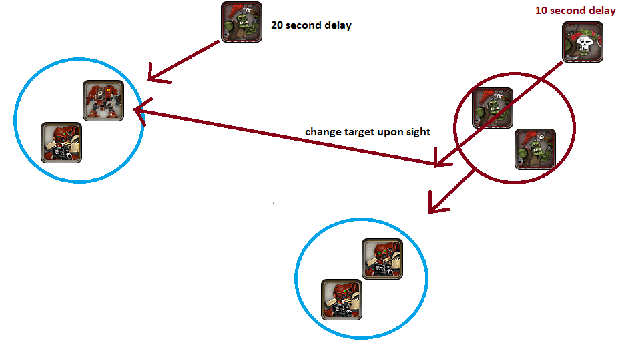
Wave 3
Two Space Marine squads (point A) One Space Marine squad, Dreadnought (point B).
Three Ork melee units One Ork rocket unit
Notes:
In this scenario the subject is told to hold two different points. One point is defended by two Space Marine squads (point A) and the other by a single Space Marine squad and a dreadnought (point B). Until the fighting starts the units must stay by their points, though once it does start they can be moved wherever they are needed.
The wave starts with two Ork melee units attacking point A, this point would then be attacked by Ork rocket launcher units until the dreadnought comes into view in which case it will attack that, after this point B is attacked by a single Ork melee unit.
Here there are several things that should be noticed,
1 that Point A is going to be over run
2 that the rockets are attacking
3 that Point B is being attacked after the battle has started.

Slide 15
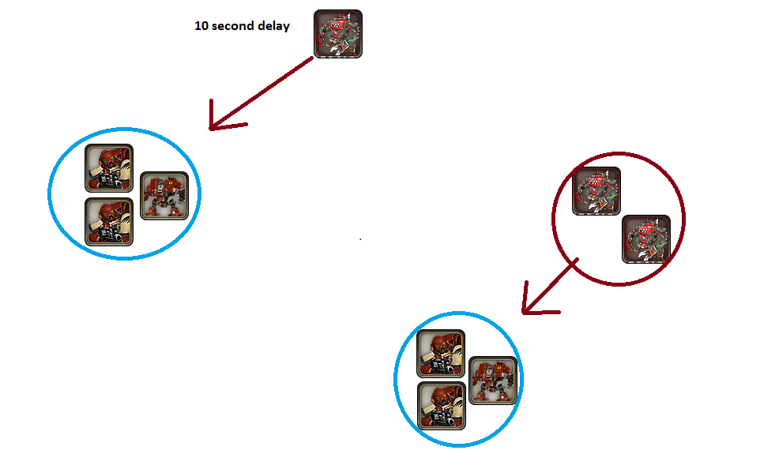
Wave 4
Two Space Marine squads, Dreadnought (point a), Two Space Marine squads, Dreadnought (point b)
Three Ork Mech units
Notes:
In this wave the subject has two Space Marine squads at point A and B along with a Dreadnought at both A and B.
Point A is attacked by two Ork mech units, shortly after this Point B is attacked by a single Ork mech unit.
The thing to notice during this round is the mech attacking Point B

Slide 17
Results
Wave | Vital Information | How many subjects noticed the information | How many subjects didn’t notice the information
2 | There are rocket units attacking the your tank unit | Large- 0 Small- 1 | Large- 4 Small- 2
3 | There are rockets attacking your tank unit and you are being attacked off screen | Large- 2 Small- 3 | Large- 2 Small- 0
4 | You are being attacked off screen | Large- 3 Small- 1 | Large- 1 Small- 2

Slide 18
Conclusion
From the data that I have there doesn’t appear to be and advantage to playing RTS games on a larger screen. Of the test waves for the large display in 41% of them the subject noticed the important information, meanwhile 55% on the small display noticed them.

Slide 19
Validity Threats
Small sample size
Only one participant had any experience with the game before.
Units have trouble pathfinding when bunched together
Computer had difficulty running the game
AI didn’t work consistently
Notes:
SHORTEN

Slide 20
Future work
Do the study with a larger sample size
Use a game that people have actually played like Starcraft II
Expand the work to other genres of video games.

Slide 21
Questions
Notes:
Add analysis slide

